Slide 1

Disentangling patterns of T cells
Evgeniya Lokes and Janine Berndt
27.06.2024
24S | Machine Learning with TensorFlow

Slide 2
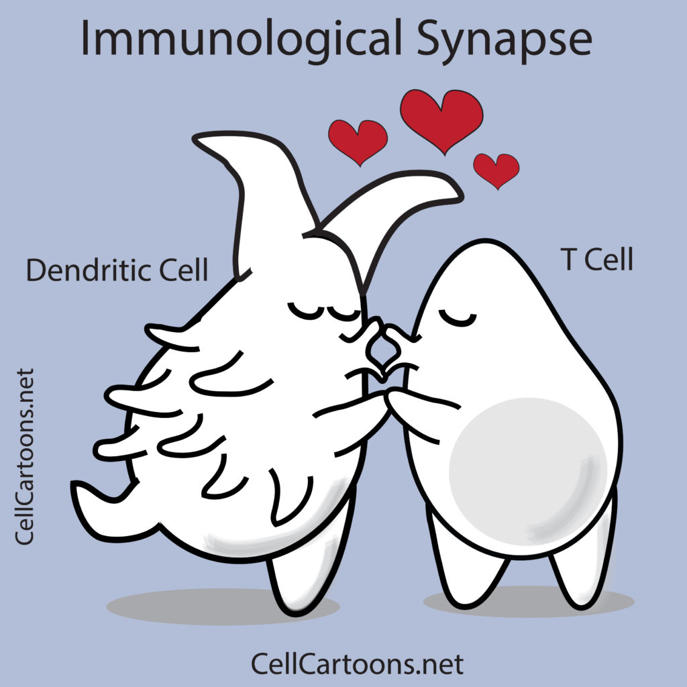
Gentle intro to T cells
Notes:
What are T cells in a nutshell:
T cells are a type of white blood cell that play a central role in the immune system. They are primarily found in the blood, lymph nodes, spleen, and thymus. T cells originate from stem cells in the bone marrow and mature in the thymus. Their functions include identifying and killing infected or cancerous cells, coordinating the immune response, and remembering past infections to provide long-term immunity.
The thymus is a small organ located in the upper chest, just behind the sternum. It is a vital part of the immune system, where T cells mature and become functional. The thymus is most active during childhood and gradually shrinks with age. It plays a critical role in developing a strong and effective immune system by educating T cells to recognize and respond to pathogens while avoiding attacks on the body's own tissues.

Slide 3
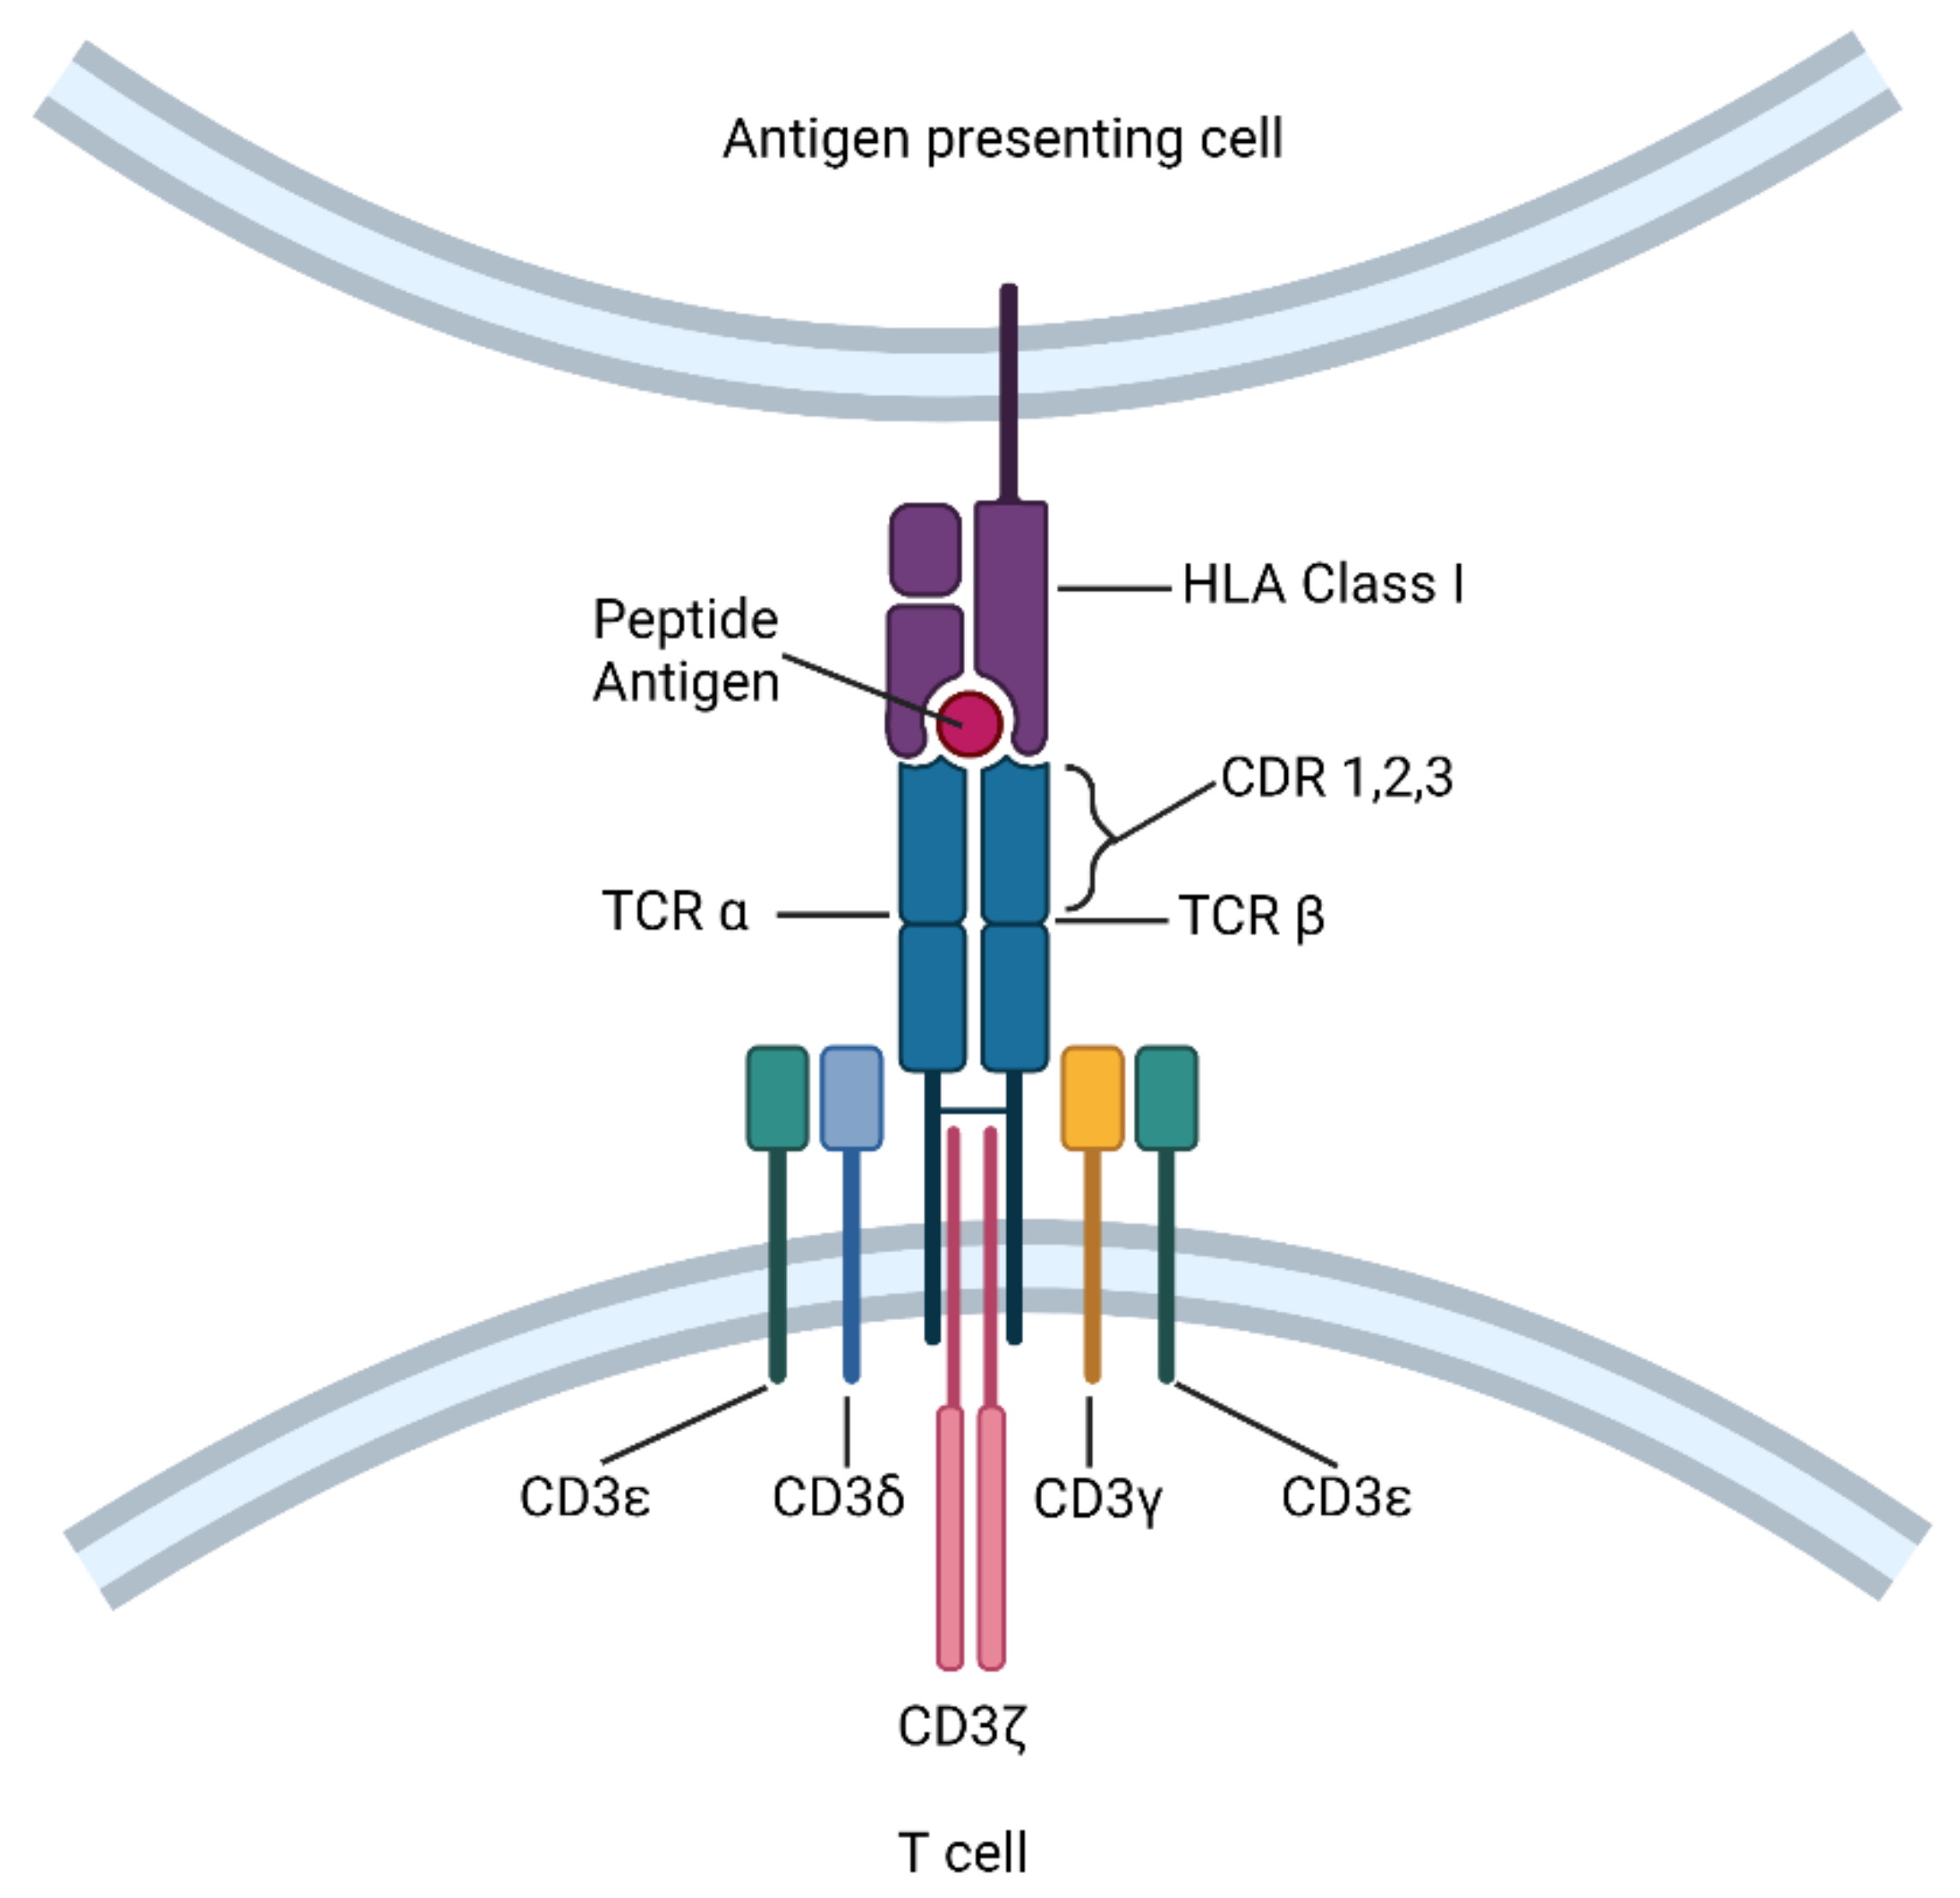

Just cells, doing their business
Randomly generated
sequences
T cell
Notes:
This image depicts a T cell receptor (TCR) on the surface of a T cell. The receptor interacts with a peptide antigen presented by another cell. The diagram highlights that the sequences of the TCR are randomly generated, allowing T cells to recognize a diverse array of antigens.
The caption "Just cells, doing their business" humorously underscores the routine yet crucial role of T cells in the immune system.

Slide 4
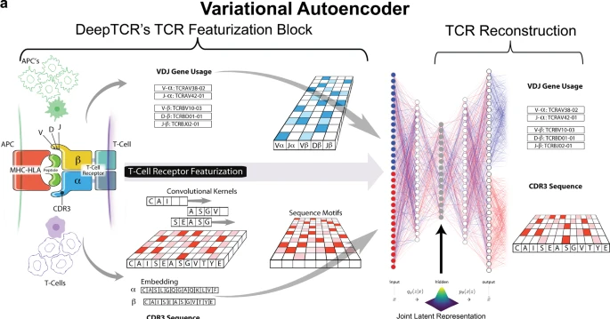
Literature
DeepTCR is a deep learning framework for revealing sequence concepts within T-cell repertoires. John-William Sidhom, H. Benjamin Larman, Drew M. Pardoll & Alexander S. Baras. Nature Communications (2021)
Notes:
As background information and maybe a kind of guideline for starting the project served the article by Sidhom et al.

Slide 5
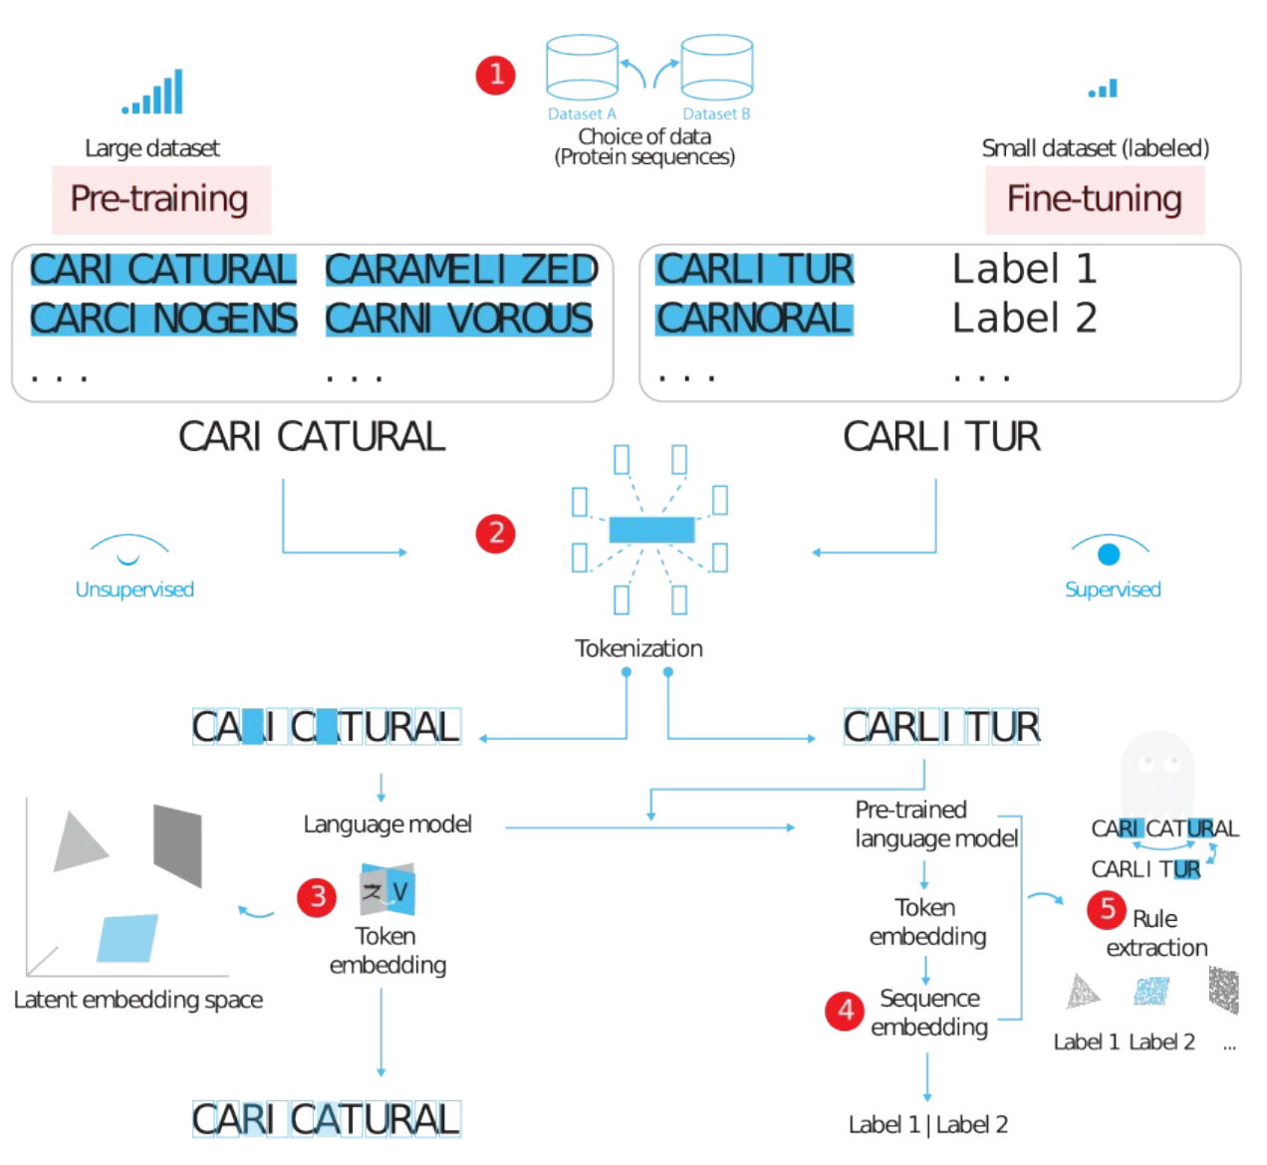
Linguistically inspired roadmap for building biologically reliable protein language models. Mai Ha Vu, Rahmad Akbar, Philippe A. Robert, Bartlomiej Swiatczak, Geir Kjetil Sandve, Victor Greiff & Dag Trygve Truslew Haug. Nature Machine Intelligence (2023)
Notes:
as well as the paper of Mai Ha Vu et al.
Due to the nature of the data we decided to choose a linguistically inspired approach.

Slide 6
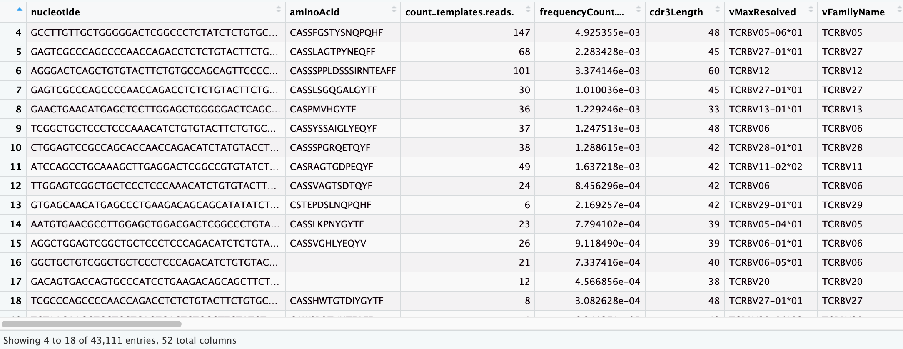
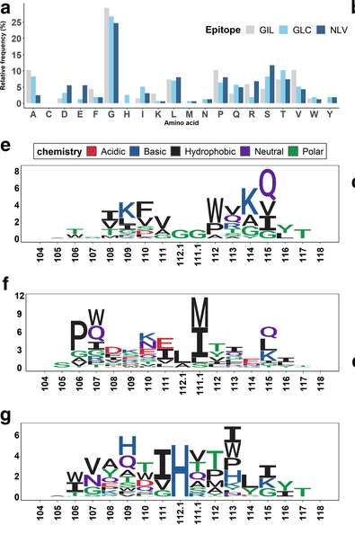
Using public datasets of T cell repertoire of patients
Each person has 10^10 sequences….a lot
Most of them are private….
Can we find patterns and predict?
Overfitting to prove data NOT RANDOM
Notes:
We used datasets of T cell receptoire of patients from a public database
10 (raised) to the power of 10
Our goal:
Can we find patterns and predict?
Prove with overfitting that data is NOT RANDOM

Slide 7
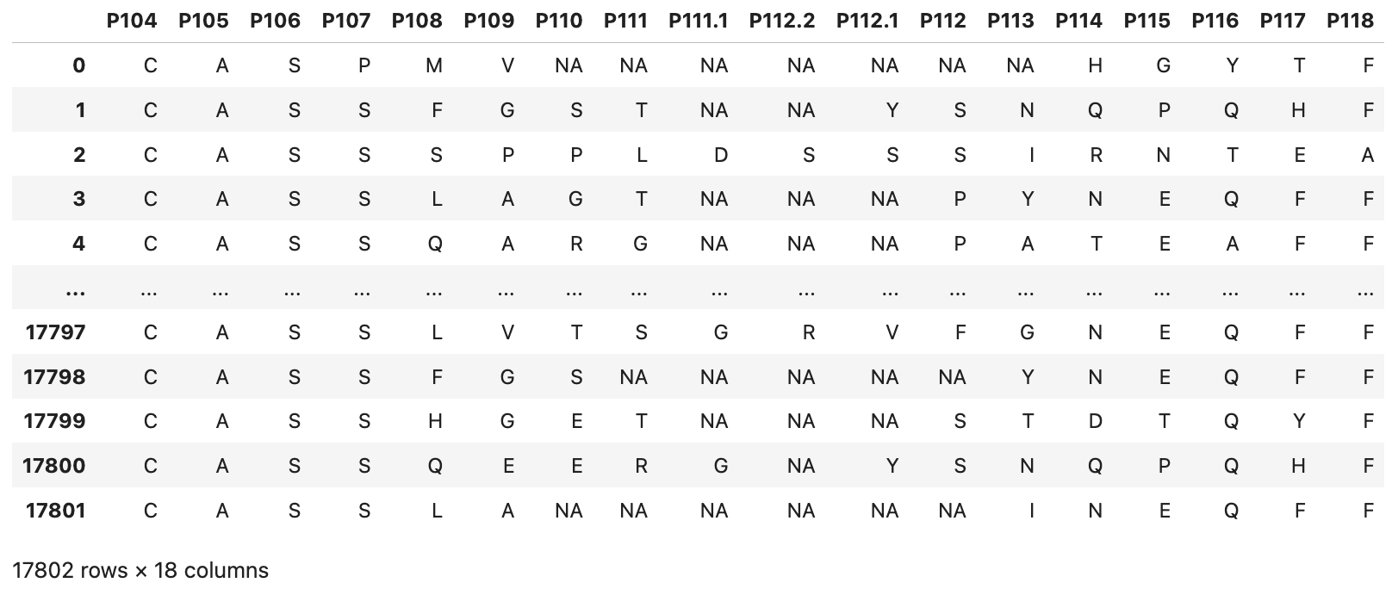
Dataset (Part of receptor with random sequence)
Dataset cleaning
Preprocessing the dataset (pivoting and transforming for usage)
Nature of receptor sequences starting with CAS and ending with F for 34 patients
Notes:
We have choosen the part of receptor with random sequence.
Here is a sample: To start as simple as possible, we have been in particaular been interested in sequences starting with CAS and ending with F
Real values in the dataset – NA only introduced when we manipulated data for processing

Slide 8
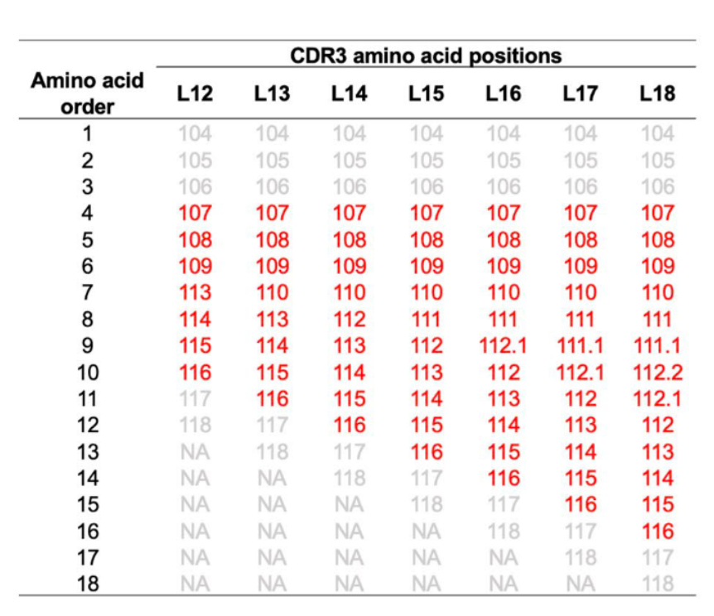
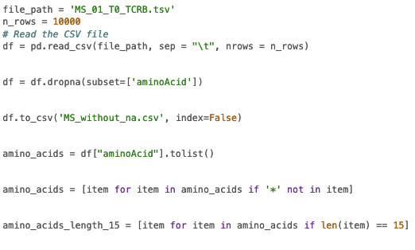
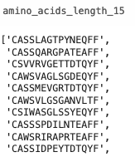
2. Reducing length and introducing dictionary
Selecting only length==15 (uniqueness – all reference positions are present)

Slide 9
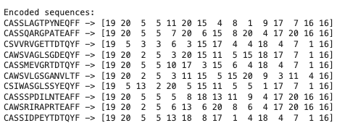
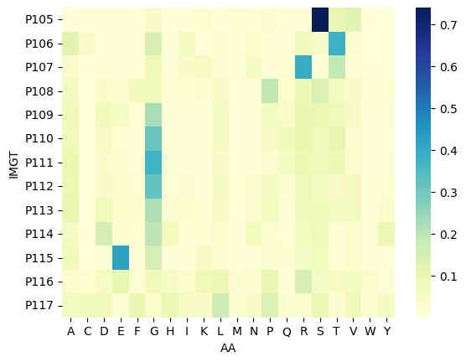
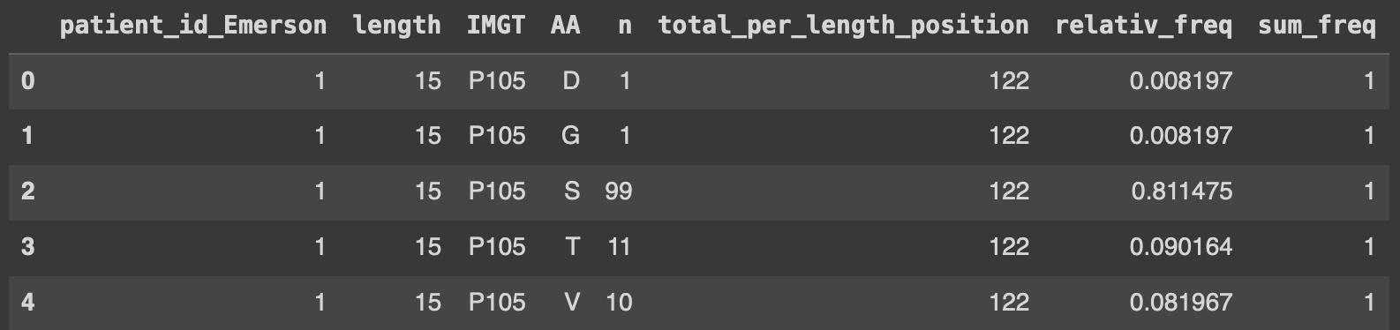
Introducing dictionary
Letter to number mapping: {'P': 8, 'C': 19, 'D': 18, 'N': 9, 'Q': 7, 'I': 13, 'S': 5, 'W': 2, 'M': 10, 'G': 15, 'A': 20, 'R': 6, 'F': 16, 'E': 17, 'H': 14, 'T': 4, 'Y': 1, 'V': 3, 'K': 12, 'L': 11}
Notes:
Real values in the dataset – NA only introduced when we manipulated data for processing
e.g. predicting fifth position should give us most likely G
IMGT - ImMunoGeneTics

Slide 10
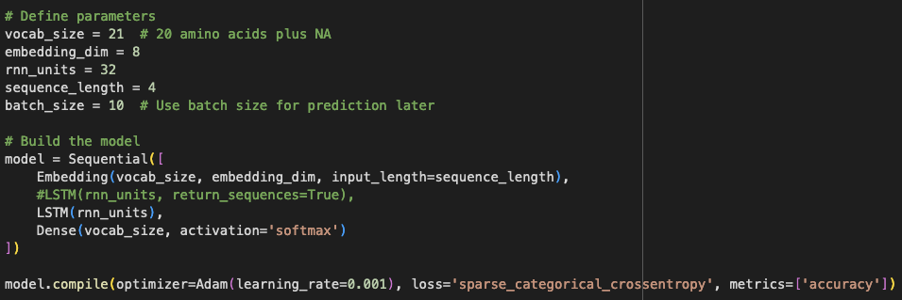
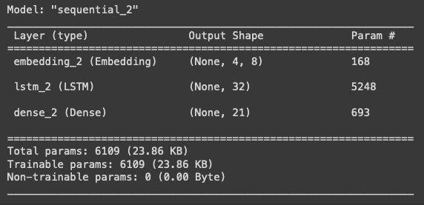
Baseline Model
Model ⎯ predicting the fifth position (removing column 1-3, -2)
1. Run ⎯ 10 epochs
2. Run ⎯ 100 epochs
3. Run ⎯ 1000 epochs (try overfitting to determing if model is actually learning)
Notes:
RNN stands for Recurrent Neural Network.
RNNs are a type of artificial neural network designed for processing sequences of data, such as time series, text, or other sequential information.
Here’s a brief overview of their key characteristics and applications:
Key Characteristics of RNNs
Sequential Data Handling:
RNNs are specifically designed to handle sequential data where the order of the data points matters. This makes them suitable for tasks like language modeling, time series prediction, and speech recognition.
Recurrent Connections:
Unlike traditional neural networks, RNNs have connections that loop back on themselves, allowing them to maintain a hidden state that can carry information across different steps in the sequence. This hidden state helps RNNs capture temporal dependencies and patterns in the data.
Parameter Sharing:
RNNs share the same parameters across all steps in the sequence, which helps in reducing the number of parameters and makes the model more generalizable.
Applications of RNNs
Natural Language Processing (NLP):
Tasks such as language modeling, machine translation, text generation, and sentiment analysis often use RNNs to capture the context and dependencies within the text.
Time Series Prediction:
RNNs are used for forecasting future values in time series data, such as stock prices, weather data, and sensor readings.
Speech Recognition:
RNNs can model the temporal dependencies in speech data, making them suitable for recognizing and transcribing spoken language.
Video Analysis:
RNNs can analyze sequences of frames in video data, enabling tasks such as action recognition and video captioning.
Common Variants of RNNs
LSTM (Long Short-Term Memory):
LSTMs are a type of RNN designed to handle long-term dependencies more effectively. They use special gates to control the flow of information and mitigate issues like the vanishing gradient problem.
GRU (Gated Recurrent Unit):
GRUs are a simplified version of LSTMs that also aim to capture long-term dependencies but with fewer parameters.

Slide 11
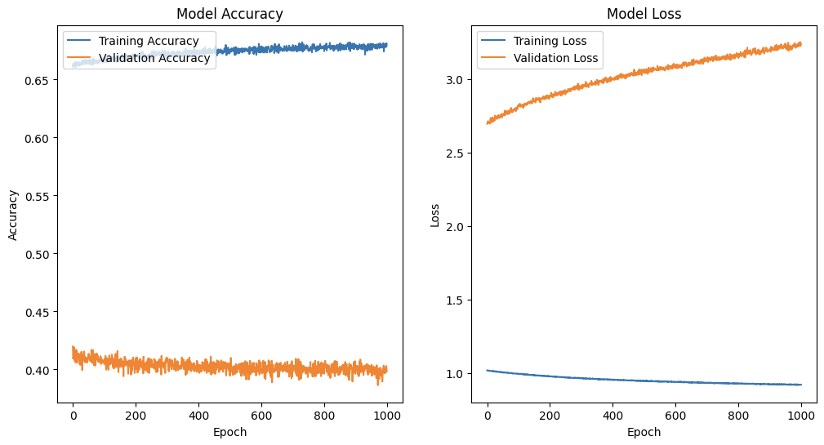
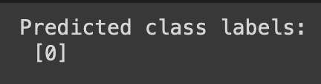
Training Curves
Training Accuracy: The training accuracy is high, approaching 0.67 (67%), and shows a steady increase over time. This indicates that the model is effectively learning the training data.
Training Loss: The training loss decreases consistently, reaching a low value close to 1.0, which suggests that the model is minimizing the error on the training set.
Validation Curves
Validation Accuracy: The validation accuracy remains low, around 0.40 (40%), and shows significant fluctuation without a clear upward trend. This suggests that the model is not improving its performance on the validation set.
Validation Loss: The validation loss increases over time, starting from about 2.0 and reaching above 3.0. This indicates that the model's performance on the validation set is worsening as training progresses, a clear sign of overfitting.
Notes:
Observations
Training Curves
Training Accuracy: The training accuracy is high, approaching 0.67 (67%), and shows a steady increase over time. This indicates that the model is effectively learning the training data.
Training Loss: The training loss decreases consistently, reaching a low value close to 1.0, which suggests that the model is minimizing the error on the training set.
Validation Curves
Validation Accuracy: The validation accuracy remains low, around 0.40 (40%), and shows significant fluctuation without a clear upward trend. This suggests that the model is not improving its performance on the validation set.
Validation Loss: The validation loss increases over time, starting from about 2.0 and reaching above 3.0. This indicates that the model's performance on the validation set is worsening as training progresses, a clear sign of overfitting.
Analysis
Overfitting: The model is overfitting to the training data. This is evident from the high training accuracy and low training loss contrasted with the low validation accuracy and increasing validation loss. The model performs well on the training set but fails to generalize to the validation set.
Model Complexity: The complexity of the model might be too high for the given data. With a high number of parameters, the model can fit the training data very well, but it might not generalize to new data.

Slide 12
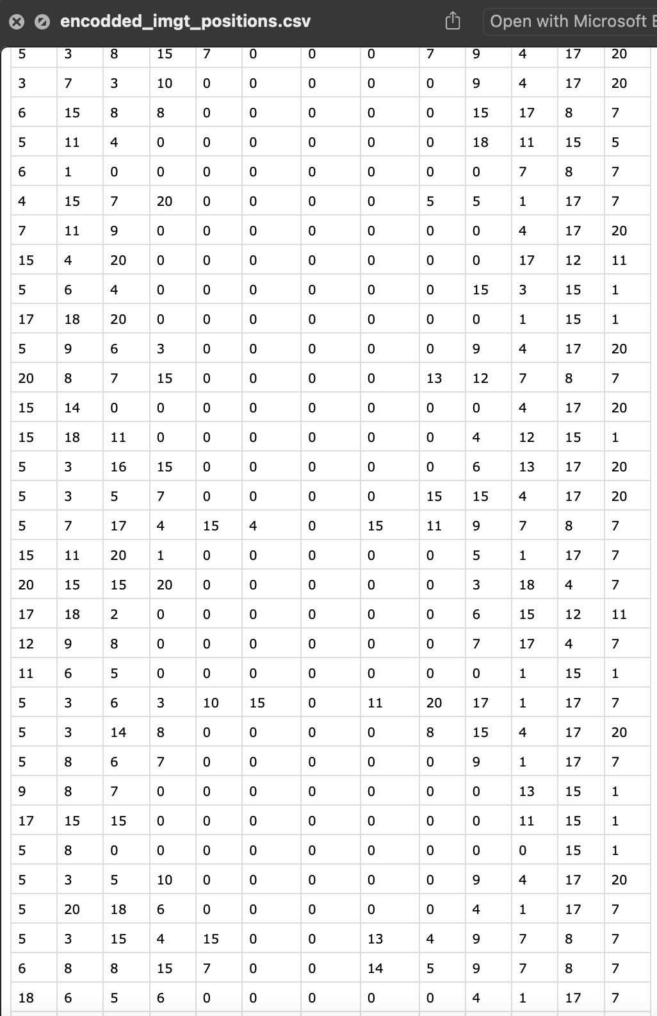
Zero as a predicted value

Slide 13
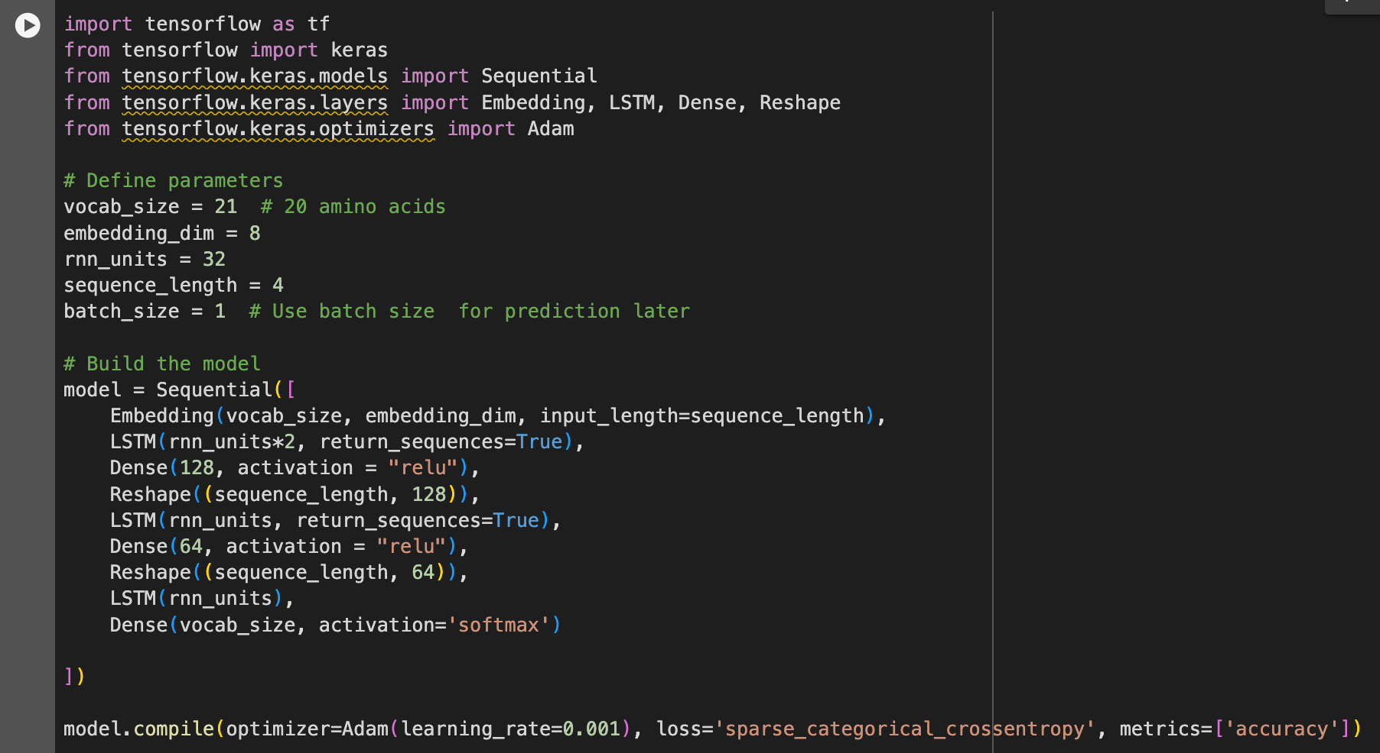
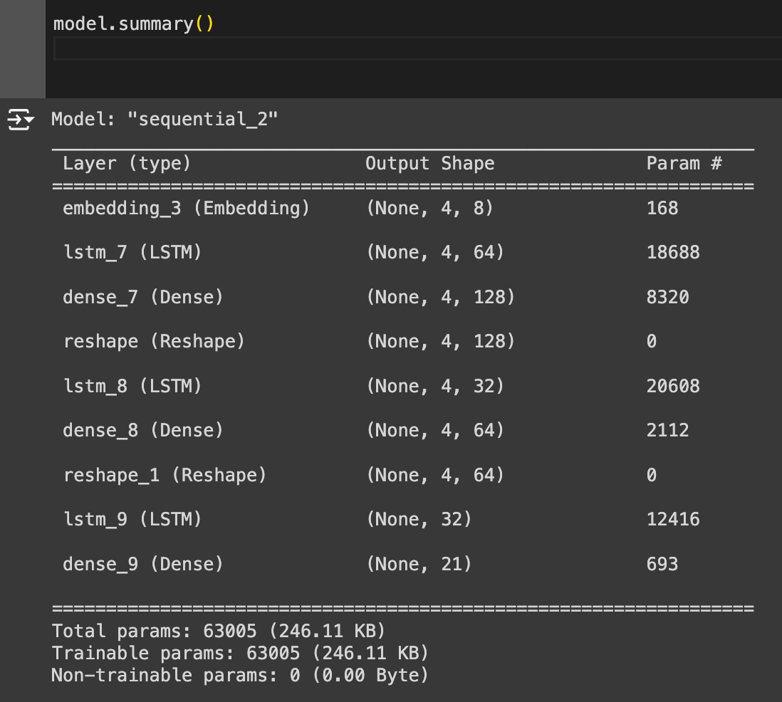
Improving the Baseline Model with LSTM
2. Model ⎯ predicting the fifth position (removing column 1-3, -2 + some middle positions ZEROs removed)
Notes:
Overall Objective
The overall objective of this model is to process sequential data (sequence of amino acids in the random part of a receptor) and predict the next letter (amino acid) in the sequence. This type of model is commonly used in natural language processing tasks such as language modeling, text generation, and machine translation. The multiple LSTM layers allow the model to capture complex dependencies and patterns in the input sequences, while the Dense layers help in refining and processing the features extracted by the LSTM layers.
In the context of LSTM (Long Short-Term Memory) networks, "long-term dependencies" refer to the ability of the model to remember and utilize information from far back in the input sequence. Unlike traditional RNNs (Recurrent Neural Networks), which struggle with maintaining relevant information over long sequences due to issues like vanishing and exploding gradients, LSTMs use gates (input, forget, and output gates) to control the flow of information and maintain long-term memory. This allows LSTMs to capture and learn patterns that span over longer time intervals effectively.

Slide 14
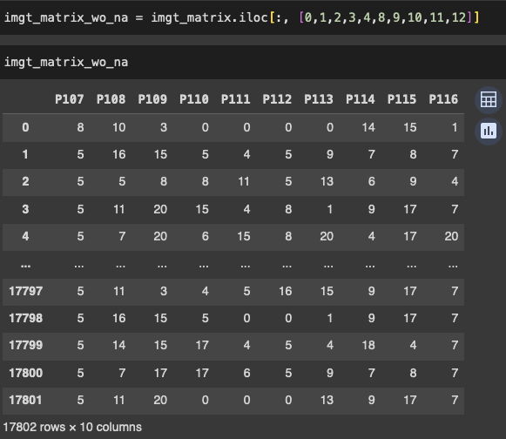
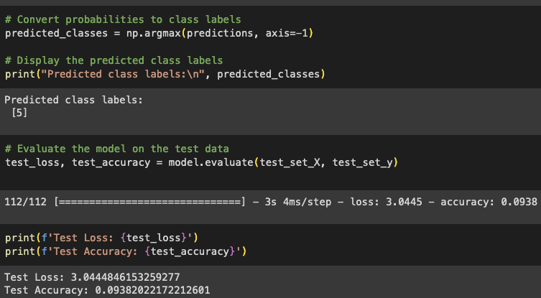
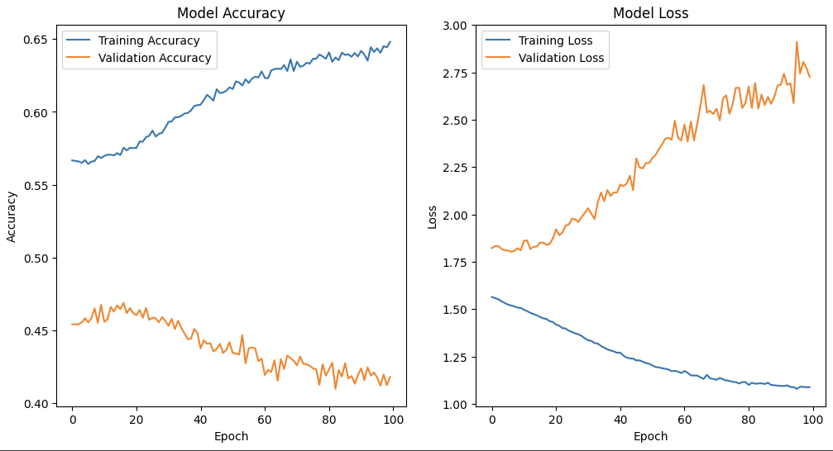
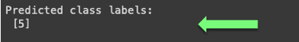
Model Accuracy
Training Accuracy: The training accuracy steadily increases and reaches around 0.65 (65%) by the 100th epoch.
Validation Accuracy: The validation accuracy decreases over time and stabilizes around 0.40 (40%).
Model Loss
Training Loss: The training loss consistently decreases and reaches around 1.1 by the 100th epoch.
Validation Loss: The validation loss increases over time and stabilizes around 2.75, showing high variability.
Analysis
→ Not overfitting → data IS RANDOM
Notes:
Analysis
Overfitting: The increasing training accuracy and decreasing training loss, combined with the decreasing validation accuracy and increasing validation loss, clearly indicate that the model is overfitting. The model is learning the training data very well but is failing to generalize to the validation data.

Slide 15
Result
Baseline Model
(predicting the fifth position (removing column 1-3, -2)
→ 1000 epochs: High Training Accurancy 67 % + Learning + Overfitting
Predicted mainly ZEROs
Model with LSTM
(predicting the fifth position (removing column 1-3, -2 + some middle positions ZEROs removed)
⎯ First version →
30 epochs
100 epochs
1000 epochs with increased batch sizes
→ High Training Accurancy 65 % + not Overfitting
→ Increasing the sample sizes
→ Add genetic data for adding possible patterns
Notes:
IMGT (International ImMunoGeneTics Information System) database

Slide 16
Could not archive
Overfit
=
Data IS RANDOM

Slide 17
Thank you for your attention
Evgeniya Lokes and Janine Berndt
24S | Machine Learning with TensorFlow

